Slide 1


Internet of Things
(IoT)

Slide 2
Internet of Things(IoT) - Syllabus
UNIT – 3 :- DESIGN AND DEVELOPMENT ENVIRONMENT
Design Methodology, Embedded computing logic, Microcontroller, System on Chips, IoT system building blocks, Arduino, Node MCU Board details, IDE programming.
Lecture Details:
Fundamentals of IoT
Branch: CSE/CSM/CS
Semester: III-II

Slide 3
Cont..
IoT Design Methodology
The IoT Design Methodology provides a structured approach to designing, developing, and deploying Internet of Things (IoT) solutions.
It ensures that the project is efficient, scalable, secure, and meets the user’s requirements
This method can then be used to plan your own projects and take them to the next level.

Slide 4
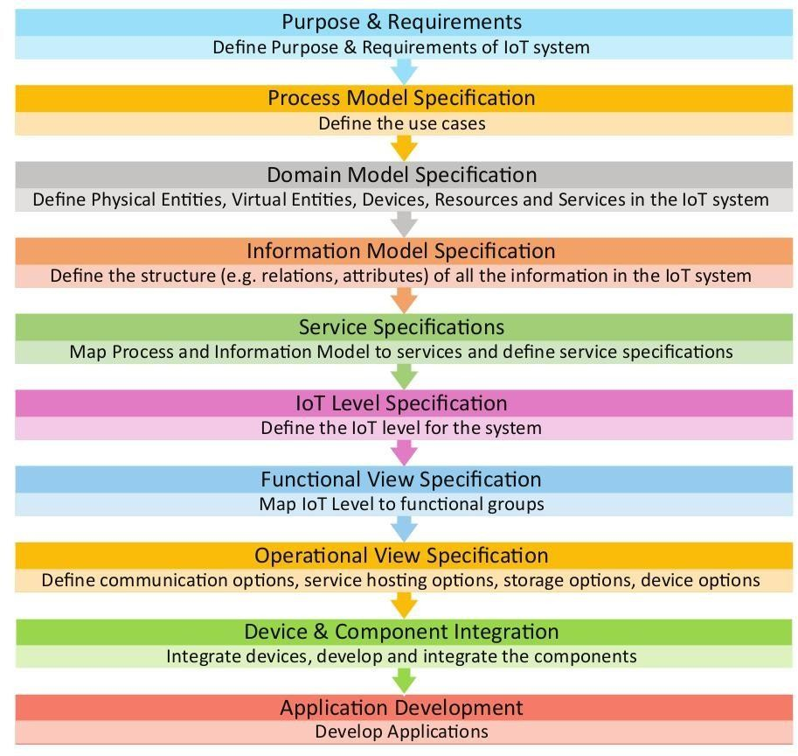
Cont..
IoT Design Methodology

Slide 5
Cont..
IoT Design Methodology
Step 1:
Purpose & Requirements Specification: Define the purpose and requirements of the system. In this step, the system purpose, behavior and requirements (such as data collection requirements, data analysis requirements, system management requirements, data privacy and security requirements, user interface requirements, ...) are captured.
Step 2:
Process Specification:. In this step, the use cases of the IoT system are formally described based on and derived from the purpose and requirement specifications are captured.

Slide 6
Cont..
IoT Design Methodology
Step 3:
Domain Model Specification: Domain model defines the attributes of the objects and relationships between objects. Domain model provides an abstract representation of the concepts, objects and entities in the IoT domain, independent of any specific technology or platform. With the domain model, the IoT system designers can get an understanding of the IoT domain for which the system is to be designed.
Step 4:
Information Model Specification: Information Model defines the structure of all the information in the IoT system, for example, attributes of Virtual Entities, relations, etc. Information model does not describe the specifics of how the information is represented or stored. To define the information model, we first list the Virtual Entities defined in the Domain Model. Information model adds more details to the Virtual Entities by defining their attributes and relations.

Slide 7
Cont..
IoT Design Methodology
Step 5:
Service Specifications: Service specifications define the services in the IoT system, service types, service inputs/output, service endpoints, service schedules, service preconditions and service effects.
Step 6:
IoT Level Specification: The sixth step in the IoT design methodology is to define the IoT level for the system.
Step 7:
Functional View Specification: The Functional View (FV) defines the functions of the IoT systems grouped into various Functional Groups (FGs). Each Functional Group either provides functionalities for interacting with instances of concepts defined in the Domain Model or provides information related to these concepts.

Slide 8
Cont..
IoT Design Methodology
Step 8:
Operational View Specification: In this step, various options pertaining to the IoT system deployment and operation are defined, such as, service hosting options, storage options, device options, application hosting options, etc.
Step 9:
Device & Component Integration: The ninth step in the IoT design methodology is the integration of the devices and components.
Step 10:
Application Development: The final step in the IoT design methodology is to develop the IoT application.

Slide 9
Cont..
EMBEDDED COMPUTING LOGIC
It is essential to know about the embedded devices while learning the IoT or building the projects on IoT.
The embedded devices are the objects that build the unique computing system. These systems may or may not connect to the Internet.
An embedded device system generally runs as a single application. However, these devices can connect through the internet connection, and able communicate through other network devices.

Slide 10
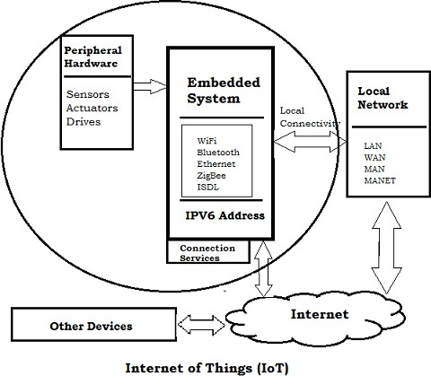
Cont..
EMBEDDED COMPUTING LOGIC

Slide 11
EMBEDDED COMPUTING LOGIC
Cont..
First developed in the 1960s for aerospace and the military, embedded computing systems continue to support new applications through numerous feature enhancements and cost- to performance improvements of microcontrollers and programmable logic devices.
Today, embedded computing systems control everyday devices which we don’t generally think of as “computers”: digital cameras, automobiles, smart watches, home appliances, and even smart garments.
These embedded computing systems are commonly found in consumer, industrial, automotive, medical, commercial, and military applications.

Slide 12
Cont..
EMBEDDED COMPUTING LOGIC
Unlike general-purpose computers, embedded control systems are typically designed to perform specific tasks.
The embedded computing system designer’s task is to identify the set of components that will implement the system’s functional, performance, usability, and reliability requirements, typically within tight cost and development timeline constraints.
Accordingly, the selection of a microcontroller and its characteristics, including data processing capabilities, speed, peripherals, and power consumption, is one of the earliest and most critical aspects of system design.
Part of the designer’s responsibility involves being aware of trends in their particular industry and taking advantage of relevant components and techniques. Let’s look for examples among the top industries for microcontroller applications, the Internet of Things.

Slide 13
Cont..
EMBEDDED SYSTEM HARDWARE
The embedded system can be of type microcontroller or type microprocessor. Both of these types contain an integrated circuit (IC).
The essential component of the embedded system is a RISC family microcontroller like Motorola 68HC11, PIC 16F84, Atmel 8051 and many more.
The most important factor that differentiates these microcontrollers with the microprocessor like 8085 is their internal read and writable memory.
The essential embedded device components and system architecture are specified below.

Slide 14
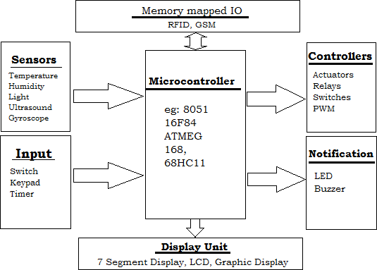
Cont..
EMBEDDED SYSTEM HARDWARE

Slide 15
Cont..
EMBEDDED SYSTEM SOFTWARE
The embedded system that uses the devices for the operating system is based on the language platform, mainly where the real-time operation would be performed.
Manufacturers build embedded software in electronics, e.g., cars, telephones, modems, appliances, etc. The embedded system software can be as simple as lighting controls running using an 8-bit microcontroller.
It can also be complicated software for missiles, process control systems, airplanes etc.

Slide 16
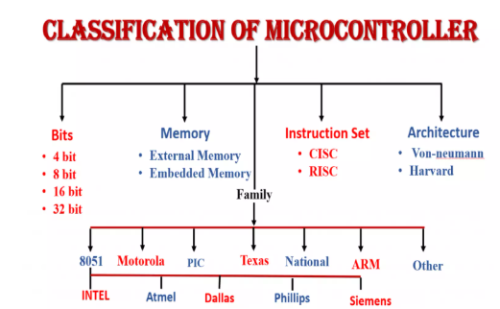
Cont..
MICROCONTROLLERS
A microcontroller is a semiconductor IC (integrated circuit)chip consists of multiple functional block such as CPU, ROM, RAM, Timer, Counter & interrupts etc. It is essentially a small computer with all peripheral inside a single package.

Slide 17
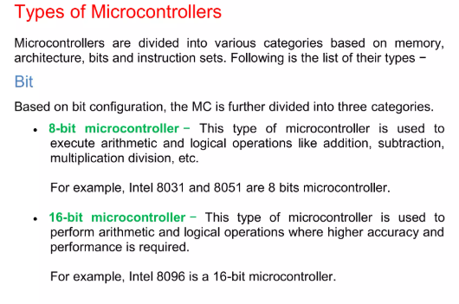
Cont..
MICROCONTROLLERS

Slide 18
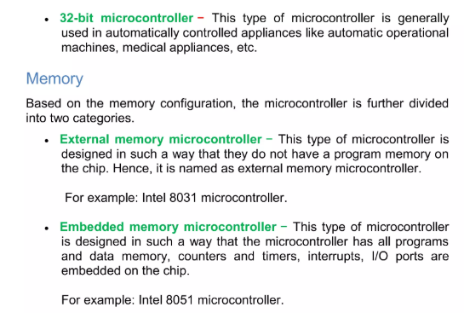
Cont..
MICROCONTROLLERS

Slide 19
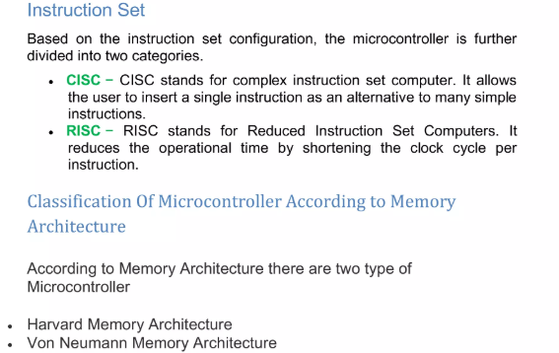
Cont..
MICROCONTROLLERS

Slide 20
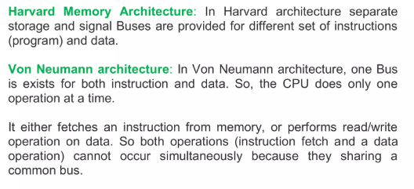
Cont..
MICROCONTROLLERS

Slide 21
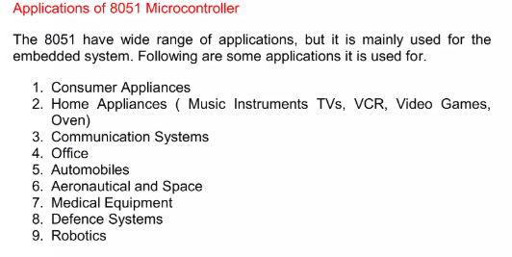
Cont..
MICROCONTROLLERS

Slide 22
Cont..
MICROCONTROLLERS
IoT devices are meant to be inexpensive, therefore the microcontroller needs to be chosen so that its capabilities are not underutilized by the application. The microcontroller specifications that determine the best part for your application are:
• Bit depth: The register and data path width impacts the speed and accuracy with which microcontrollers can perform non-trivial computations.
• Memory: The amount of RAM and Flash in a microcontroller determines the code size and complexity the component can support at full speed. Large memories have larger die area and component cost.

Slide 23
Cont..
MICROCONTROLLERS
IoT devices are meant to be inexpensive, therefore the microcontroller needs to be chosen so that its capabilities are not underutilized by the application. The microcontroller specifications that determine the best part for your application are:
• GPIO: These are the microcontroller pins used to connect to sensors and actuators in the system. These often share their functionality with other microcontroller peripherals, such as serial communication, A/D, and D/A converters.
• Power consumption: Power consumption is critically important for battery-operated devices and it typically increases with microcontroller speed and memory size.

Slide 24
Cont..
SYSTEM ON CHIPS (SoC)
System on Chip in IoT designed by Redpine Signals is discussed below.
This IoT SoC supports WLAN, bluetooth and Zigbee systems on a single chip. It also supports 2.4 and 5GHz radio frequencies.
As we know IoT is the technology which will provide communication between things, between things and people using internet and IP enabled protocols.
As we have seen in IoT tutorial any IoT compliant system will have two major parts viz. front end and back end.
Front end provides connectivity with physical world and consists of sensors while backend consists of processing and network connectivity interfaces.

Slide 25
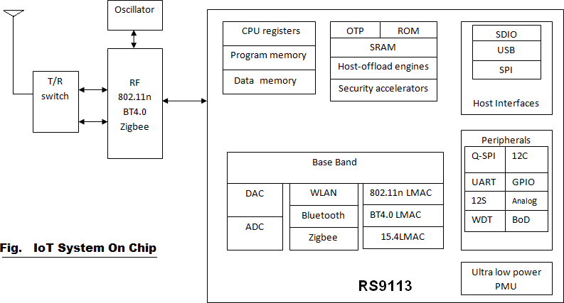
Cont..
SYSTEM ON CHIPS (SoC)

Slide 26
Cont..
SYSTEM ON CHIPS (SoC)
Typical IoT system on chip support more than one RATs (Radio Access Technologies). It will have following modules.
• Transmit and receive switch.
• RF part mainly consists of Transmitter, receiver, oscillator and amplifiers.
• Memories i.e. Program memory, data memory to store the code and data
• Physical layer(baseband processing) either on FPGA or on processor based on complexity and latency requirement.
• MAC layer and upper protocol stacks TCP/IP etc. running on processor
• ADC and DAC to provide interface between digital baseband and analog RF portions.
• Various interfaces such as SDIO, USB, SPI etc., to provide interface with the host.
• Other peripherals such as UART, I2C, GPIO, WDT etc. to use the IoT SoC for various connections.

Slide 27
Cont..
SYSTEM ON CHIPS (SoC)
As IoT system on chip supports multiple wireless protocols and RF hardware to support multiple frequency bands, following factors need to be carefully analyzed and to be optimized.
• Power-consumption
• Data-throughput
• Device-size
• Performance in terms of latency and other factors
Figure depicts one such IoT System on Chip model no. RS9113,which has been designed and developed by Redpine Signals recently. It supports WLAN (802.11n), Bluetooth version 4.0 and Zigbee (802.15.4-2006) in the same chip. Hence the IoT device can be connected with any of the said wireless technology based networks.

Slide 28
Cont..
SYSTEM ON CHIPS (SoC)
This IoT SoC (system on chip in IoT) can be used for numerous applications as mentioned below:
• Mobile
• M2M-Communication
• Real time location finding tags
• Thermostats
• Smart meters
• Wireless sensor devices
• Serial to Wi-Fi converter
• Voice Over Wi-Fi compliant phones
• Home automation
• Health care devices and equipments

Slide 29
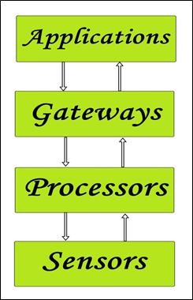
Cont..
BUILDING BLOCKS OF IoT
Four things form basic building blocks of the IoT system
Sensors,
Processors,
Gateways,
Applications.
Each of these nodes has to have its own characteristics in order to form a useful IoT system.

Slide 30
BUILDING BLOCKS OF IoT
Cont..
Sensors:
• These form the front end of the IoT devices. These are the so-called “Things” of the system. Their main purpose is to collect data from its surroundings (sensors) or give out data to its surrounding (actuators).
• These have to be uniquely identifiable devices with a unique IP address so that they can be easily identifiable over a large network.
• These have to be active in nature which means that they should be able to collect real time data. These can either work on their own (autonomous in nature) or can be made to work by the user depending on their needs (user-controlled).
• Examples of sensors are gas sensor, water quality sensor, moisture sensor, etc.

Slide 31
Cont..
BUILDING BLOCKS OF IoT
Processors:
• Processors are the brain of the IoT system. Their main function is to process the data captured by the sensors and process them so as to extract the valuable data from the enormous amount of raw data collected. In a word, we can say that it gives intelligence to the data.
• Processors mostly work on real-time basis and can be easily controlled by applications. These are also responsible for securing the data – that is performing encryption and decryption of data.
• Embedded hardware devices, microcontroller, etc., are the ones that process the data because they have processors attached to it.

Slide 32
Cont..
BUILDING BLOCKS OF IoT
Gateways:
• Gateways are responsible for routing the processed data and send it to proper locations for its (data) proper utilization.
• In other words, we can say that gateway helps in to and for communication of the data. It provides network connectivity to the data. Network connectivity is essential for any IoT system to communicate.
• LAN, WAN, PAN, etc., are examples of network gateways.

Slide 33
Cont..
BUILDING BLOCKS OF IoT
Applications:
• Applications form another end of an IoT system. Applications are essential for proper utilization of all the data collected.
• These cloud-based applications which are responsible for rendering the effective meaning to the data collected. Applications are controlled by users and are a delivery point of particular services.
• Examples of applications are home automation apps, security systems, industrial control hub, etc.

Slide 34
Cont..
ARDUINO
Arduino is an open-source hardware, software and content platform with a global community.
Arduino is an open-source electronics platform based on easy-to-use hardware and software.
Arduino boards are able to read inputs - light on a sensor, a finger on a button, or a Twitter message - and turn it into an output - activating a motor, turning on an LED, publishing something online.

Slide 35
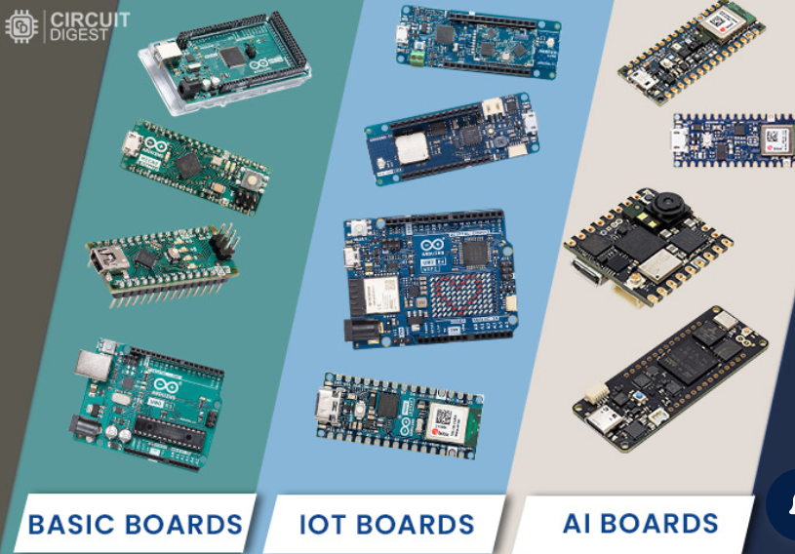
Cont..
AURDINO BOARDS

Slide 36
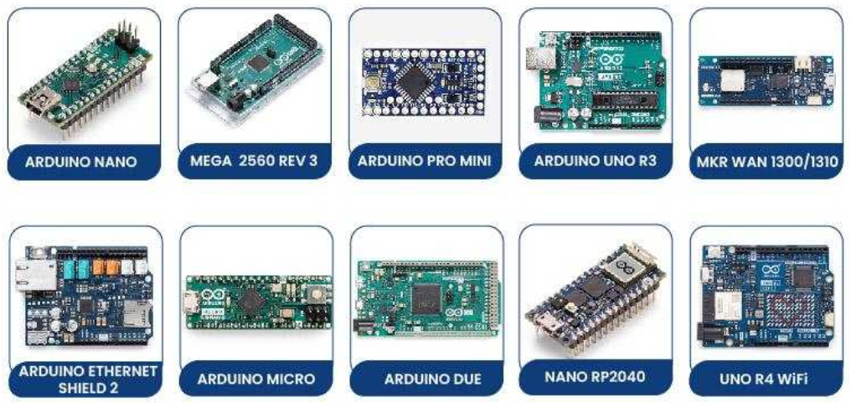
Cont..
POPULAR AURDINO BOARDS

Slide 37
Cont..
ARDUINO
Basic, most boards have either slow clock speed or a limited number of I/O ports. All these boards are powered by 8-bit microcontrollers.
Arduino Uno is the most popular and widely used development board. It is powered by an ATMega328P microcontroller.
It is cheap, easy to learn and use, and also a variety of premade modules are available for this which makes it easier for developing new projects or prototypes.

Slide 38
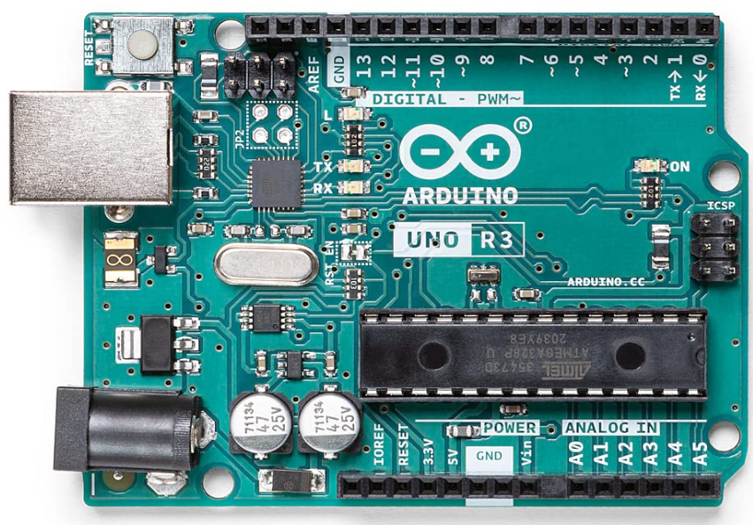
AURDINO UNO R3/ Example1
Cont..
Arduino UNO is a microcontroller board based on the ATmega328P.
14 digital input/output pins (of which 6 can be used as PWM outputs), 6 analog inputs, a 16 MHz ceramic resonator, a USB connection, a power jack, an ICSP header and a reset button.

Slide 39
AURDINO UNO R3 BOARDS
Cont..
Power USB
Arduino board can be powered by using the USB cable from your computer. All you need to do is connect the USB cable to the USB connection
Power (Barrel Jack)
Arduino boards can be powered directly from the AC mains power supply by connecting it to the Barrel Jack.
Voltage Regulator
The function of the voltage regulator is to control the voltage given to the Arduino board and stabilize the DC voltages used by the processor and other elements.

Slide 40
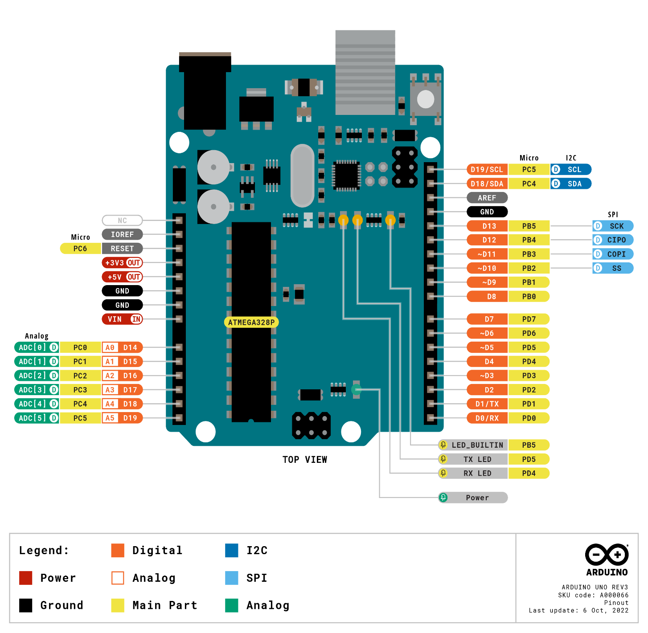
Cont..
AURDINO UNO R3 BOARDS-PIN OUT DIAGRAM

Slide 41
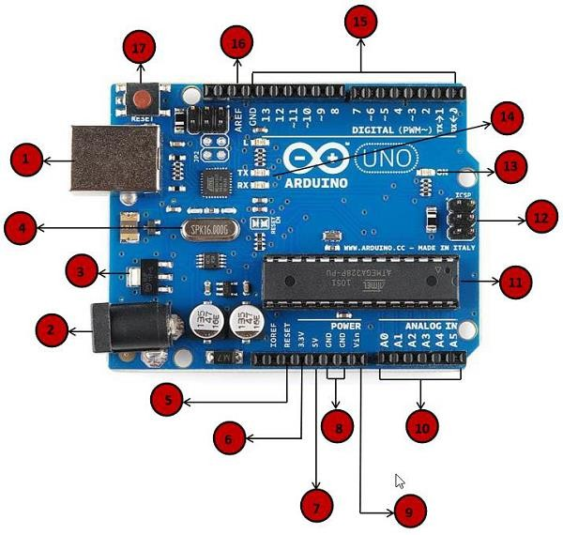
AURDINO UNO/ Example2
Cont..
1 POWER USB
2 POWER (BARREL JACK)
3 VOLTAGE REGULATOR
4 CRYSTAL OSCILLATOR
5 Arduino Reset
6,7,8,9 Pins (3.3, 5, GND, Vin)
10 Analog pins
11 Main microcontroller
12 ICSP pin
13 Power LED
indicator
14 TX and RX LEDs
15 Digital I/O
16 AREF

Slide 42
Description of Arduino Uno board
Cont..
1: Power USB
Arduino board can be powered by using the USB cable from your computer. All you need to do is connect the USB cable to the USB connection
2: Power (Barrel Jack)
Arduino boards can be powered directly from the AC mains power supply by connecting it to the Barrel Jack.
3: Voltage Regulator
The function of the voltage regulator is to control the voltage given to the Arduino board and stabilize the DC voltages used by the processor and other elements.
4: Crystal Oscillator
The crystal oscillator helps Arduino in dealing with time issues. Arduino calculate time by using the crystal oscillator. It uses 16MHz.
5, 17: Reset
You can reset your Arduino board, i.e., start your program from the beginning(pin-17) and external reset button to the Arduino(pin-5)

Slide 43
Description of Arduino Uno board
Cont..
6: Supply 3.3V output Voltage
7: Supply 5V output Voltage
8: Ground(GND):There are several GND pins on the Arduino, any of which can be used to ground your circuit.
9: Vin :This pin also can be used to power the Arduino board from an external power source, like AC mains power supply.
10: Analog Pins: The Arduino UNO board has six analog input pins A0 through A5.
These pins can read the signal from an analog sensor like the humidity sensor or temperature sensor and convert it into a digital value that can be read by the microprocessor.
11: Main Microcontroller: Each Arduino board has its own microcontroller, it as the brain of your board. The microcontrollers are usually of the ATMEL Company
The information of an IC available on the top of the IC.
12: ICSP(in-circuit serial programming):a tiny programming header for the Arduino consisting of MOSI (Master Output Slave Input):This signal is used to transfer the data from master to slave MISO (Master Input Slave Output):
SCK, Serial Clock (SCK) - The clock pulses which synchronize data transmission generated by the Controller, RESET, VCC, and GND. It is also referred as SPI (Serial Peripheral Interface)

Slide 44
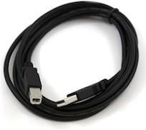
Description of Arduino Uno board
Cont..
13, 14: Power LED indicator, Tx and Rx LED’s : This LED should light up when you plug your Arduino into a power source to indicate that your board is powered up correctly.
TX (transmit) and RX (receive). They appear in two places on the Arduino UNO board. First, at the digital pins 0 and 1, to indicate the pins responsible for serial communication.
Second, the TX and RX led (13). The TX led flashes with different speed while sending the serial data.
The speed of flashing depends on the baud rate used by the board.
RX flashes during the receiving process.
Pin-15: The Arduino UNO board has 14 digital I/O pins (15) (of which 6 provide PWM (Pulse Width Modulation) output. These pins can be configured to work as input digital pins to read logic values (0 or 1) or as digital output pins to drive different modules like LEDs, relays, etc. The pins labeled “~” can be used to generate PWM.
Pin-16: AREF( Analog Reference: It is sometimes, used to set an external reference voltage (between 0 and 5 Volts) as the upper limit for the analog input pins.
USB cable: The Arduino IDE on our computer and prepare the board to receive the program via USB cable

Slide 45
Cont..
AURDINO BOARDS
• Applications Various kinds of Arduino boards are available depending on different microcontrollers used.
However, all Arduino boards have one thing in common: they are programmed through the Arduino IDE software.
The differences are based on the number of inputs and outputs. The number of sensors, leds and buttons you can use on a single board, speed, operating voltage, form factor etc.
Some boards are designed to be embedded and have no programming interface

Slide 46
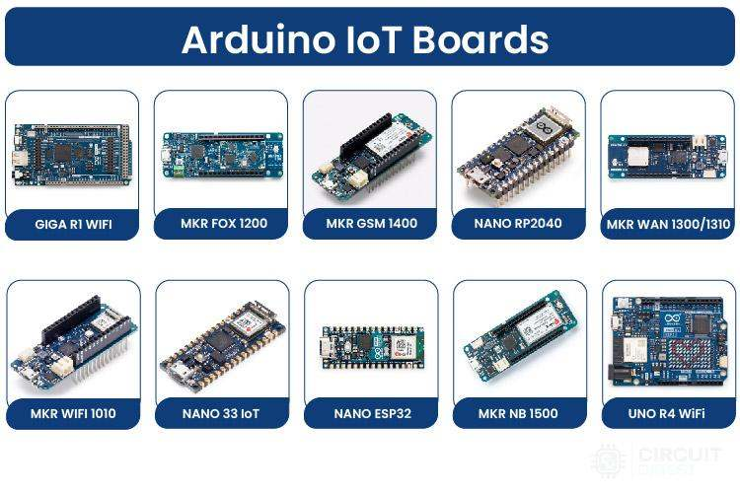
Cont..
AURDINO BOARDS

Slide 47
Cont..
AURDINO
We can program the Arduino UNO using the Arduino IDE. The Arduino IDE is the integral development program, which is common to all the boards.
We can also use Arduino Web Editor, which allows us to upload sketches and write the code from our web browser (Google Chrome recommended) to any Arduino Board. It is an online platform
The USB connection is essential to connect the computer with the board. After the connection, the PWR pins will light in green. It is a green power LED.

Slide 48
Cont..
AURDINO BOARDS
Steps
The steps to get started with Arduino UNO are listed below:
Install the drivers of the board.
As soon we connect the board to the computer, Windows from XP to 10 will automatically install the board drivers.
But, if you have expanded or downloaded the zip package, follow the below steps:

Slide 49
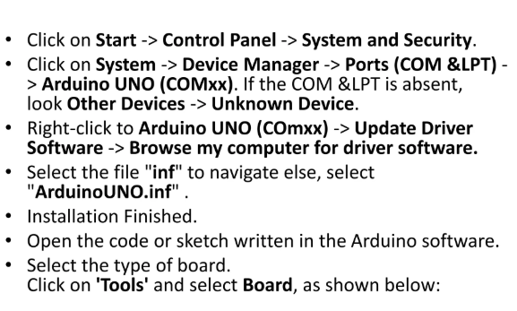
Cont..
AURDINO BOARDS

Slide 50
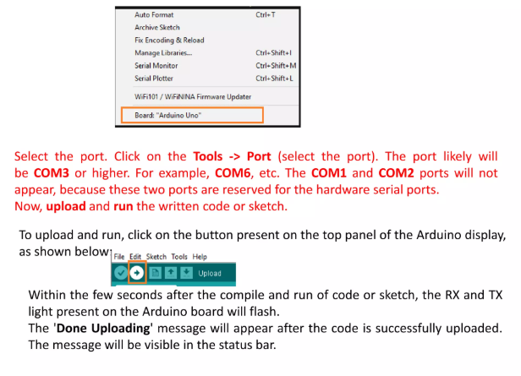
AURDINO BOARDS
Cont..

Slide 51
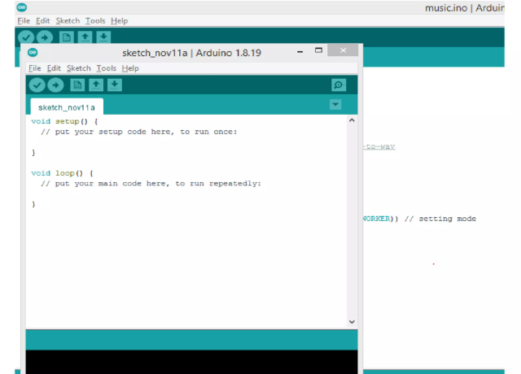
Cont..
AURDINO BOARDS

Slide 52
Cont..
AURDINO BOARDS
What is Setup? What type of code is written in the setup block?
It contains an initial part of the code to be executed.
The pin modes, libraries, variables, etc., are initialized in the setup section.
It is executed only once during the uploading of the program and after reset or power up of the Arduino board.

Slide 53
Cont..
AURDINO BOARDS
What is Loop? What type of code is written in the Loop block?
The loop contains statements that are executed repeatedly.
The section of code inside the curly brackets is repeated depending on the value of variables.

Slide 54
Cont..
AURDINO BOARDS
Time in Arduino
The time in Arduino programming is measured in a millisecond.
Where, 1 sec = 1000 milliseconds
We can adjust the timing according to the milliseconds.
For example, for a 5-second delay, the time displayed will be 5000 milliseconds.

Slide 55
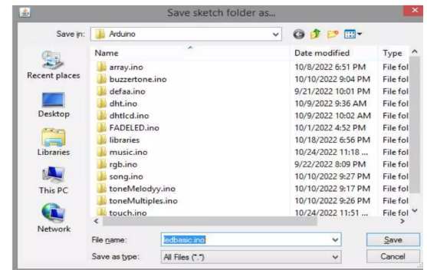
Cont..
AURDINO BOARDS

Slide 56
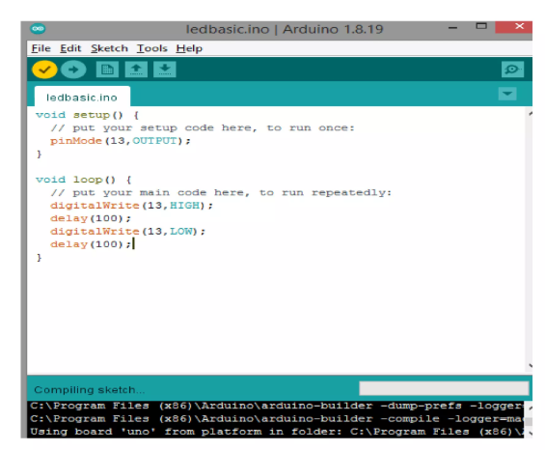
Cont..
AURDINO BOARDS

Slide 57
Cont..
AURDINO BOARDS
pinMode()
The specific pin number is set as the INPUT or OUTPUT in the pinMode () function.
The syntax is: pinMode(pin, mode) where,
Pin: It is the pin number. We can select the pin number according to the requirements.
Mode: We can set the mode as INPUT or OUTPUT according to the corresponding pin number.
Example: We want to set the 13 pin number as the output pin.
Code:
pinMode (13, OUTPUT);

Slide 58
Cont..
AURDINO BOARDS
digitalWrite()
The digitalWrite () function is used to set the value of a pin as HIGH or LOW. Where,
HIGH: It sets the value of the voltage. For the 5V board, it will set the value of 5V, while for 3.3V, it will set the value of 3.3V.
LOW: It sets the value = 0(GND).
If we do not set the pinMode as OUTPUT, the LED may light dim.
The syntax is: digitalWrite(pin, value HIGH/LOW)
Pin: We can specify the pin number or the declared variable.

Slide 59
Cont..
AURDINO BOARDS
Let’s understand with an example.
Example:
digitalWrite (13, HIGH);
digitalWrite (13, LOW);
The HIGH will ON the LED and LOW will OFF the LED connected to pin number 13.

Slide 60
Cont..
AURDINO BOARDS
What is the difference between digitalRead () and digitalWrite ()?
The digitalRead () function will read the HIGH/LOW from the digital pin, and the digitalWrite () function is used to set the HIGH/LOW value of the digital pin.
delay()
The delay () function is a blocking function to pause a program from doing a task during the specified duration in milliseconds.
For example, - delay (2000)
Where, 1 sec = 1000 millisecond

Slide 61
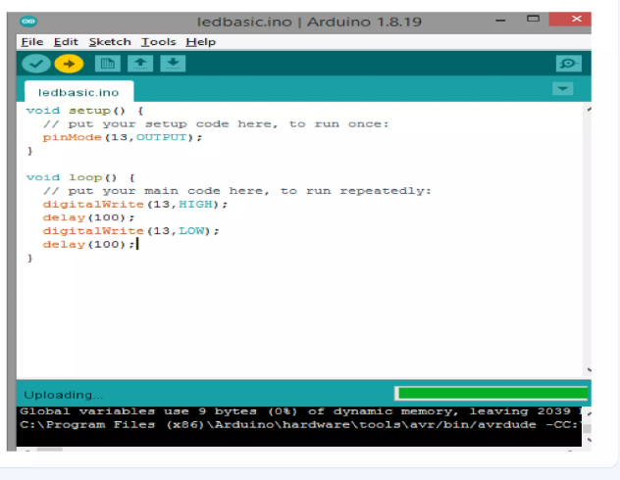
Cont..
AURDINO BOARDS

Slide 62
LED BLINK PROGRAM
Cont..
Turn an LED on and off every second.
// the setup function runs once when you press reset or power the board
void setup() { // initialize digital pin LED_BUILTIN as an output.
pinMode(LED_BUILTIN, OUTPUT);
}
// the loop function runs over and over again forever
void loop() {
digitalWrite(LED_BUILTIN, HIGH); // turn the LED on (HIGH is the voltage level) delay(1000); // wait for a second
digitalWrite(LED_BUILTIN, LOW); // turn the LED off by making the voltage LOW delay(1000); // wait for a second
}

Slide 63
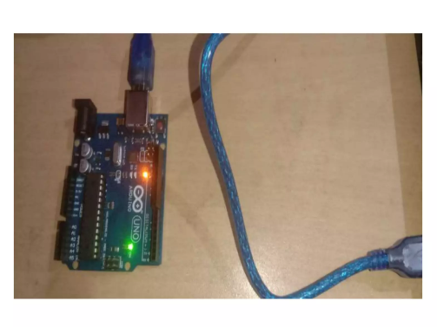
Cont..
AURDINO BOARDS

Slide 64
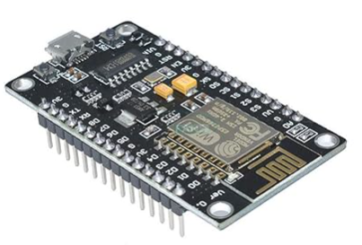
Cont..
Node MCU
The NodeMCU (Node Microcontroller Unit) is an open source software and hardware development environment that is build around a very inexpensive System-on-a-Chip (SoC) called the ESP8266.
An Arduino-like device
Main component:ESP8266 with programmable pins and built-in wi-fi.
Power via USB
Low cost

Slide 65
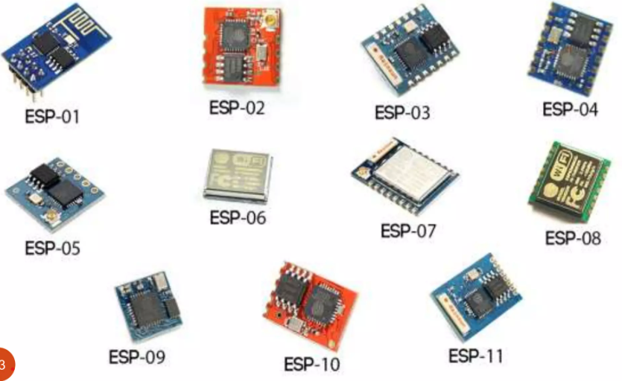
Cont..
TYPES OF Node MCU

Slide 66
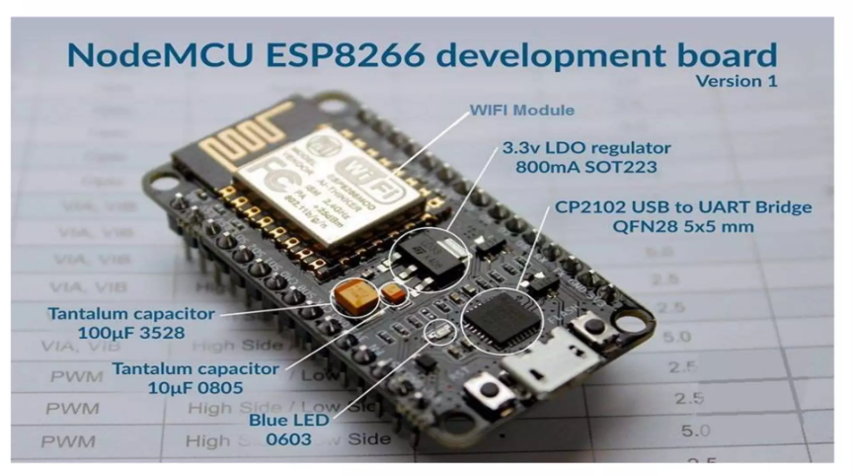
Cont..
Node MCU Main Component

Slide 67
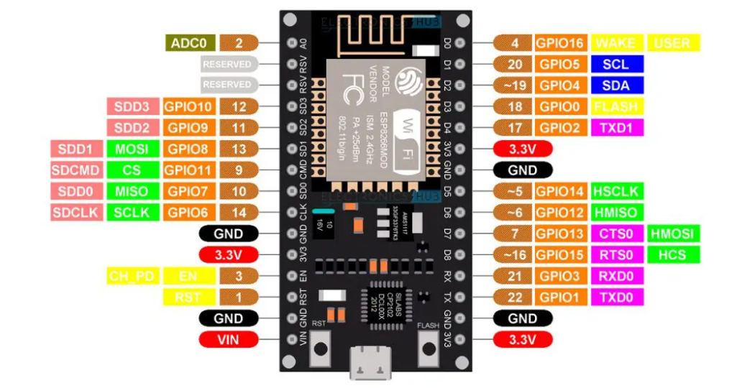
Cont..
Node MCU PIN DESCRIPTION

Slide 68
SINGLE LED BLINK PROGRAM USING WEB
Cont..
#include <ESP8266WiFi.h> // For ESP8266 (use <WiFi.h> for ESP32)
#include <ESP8266WebServer.h> // For ESP8266 (use <WebServer.h> for ESP32)
const char* ssid = "Your_SSID"; // Replace with your Wi-Fi network name
const char* password = "Your_PASSWORD"; // Replace with your Wi-Fi password
// Pin configuration
const int ledPin = 2; // GPIO2 (D2 on ESP8266, can be different on ESP32)

Slide 69
SINGLE LED BLINK PROGRAM USING WEB
Cont..
ESP8266WebServer server(80); // Web server running on port 80 (HTTP)
void setup() {
Serial.begin(115200);
// Connect to Wi-Fi
WiFi.begin(ssid, password);
while (WiFi.status() != WL_CONNECTED) {
delay(500);
Serial.print(".");
}
Serial.println("Connected to Wi-Fi!");

Slide 70
SINGLE LED BLINK PROGRAM USING WEB
Cont..
// Set the LED pin as an output
pinMode(ledPin, OUTPUT);
// Define routes for the web server
server.on("/", HTTP_GET, handleRoot);
server.on("/blink", HTTP_GET, handleBlink);
// Start the server
server.begin();
Serial.println("Server started!");
}

Slide 71
SINGLE LED BLINK PROGRAM USING WEB
Cont..
void loop() {
server.handleClient(); // Handle incoming web requests
}
// Root page, displays a simple webpage with a button
void handleRoot() {
String html = "<html><body>";
html += "<h1>LED Blink Control</h1>";
html += "<p><a href=\"/blink\"><button>Toggle LED</button></a></p>";
html += "</body></html>";
server.send(200, "text/html", html);
}

Slide 72
SINGLE LED BLINK PROGRAM USING WEB
Cont..
// Blink the LED when '/blink' is accessed
void handleBlink() {
digitalWrite(ledPin, HIGH); // Turn the LED on
delay(500); // Wait for 500 ms
digitalWrite(ledPin, LOW); // Turn the LED off
delay(500); // Wait for 500 ms
// Send back a response
server.send(200, "text/html", "<html><body><h1>LED Blinking!</h1><a href=\"/\">Back to Control</a></body></html>");
}

Slide 73
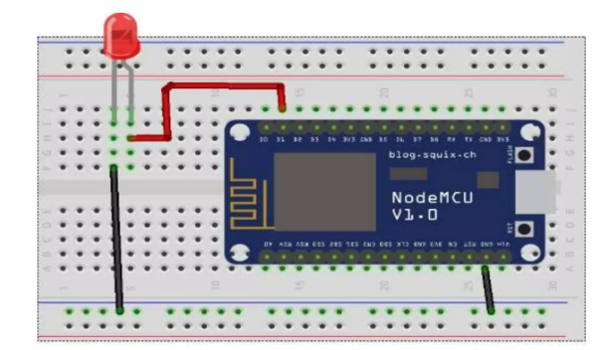
INTERFACING WITH NodeMCU
Cont..

Slide 74
Cont..
IDE PROGRAMMING
• IoT programming in IDEs involves creating software for devices like sensors, actuators, microcontrollers, and gateways. These devices are designed to connect to the internet and communicate with other devices or cloud services.
Core Features for IoT IDEs:
Device Compatibility: Support for microcontrollers (e.g., Arduino, ESP32, Raspberry Pi).
Cross-Platform Development: Tools for developing firmware, edge computing applications, and cloud integrations.
Communication Protocols: Libraries for MQTT, CoAP, HTTP, Bluetooth, and Zigbee.
Real-Time Monitoring: Tools to debug and test real-time data.
Power Optimization: Features for analyzing and optimizing power consumption.

Slide 75
Cont..
IDE PROGRAMMING
Essential Components of IoT IDEs
1. Code Editor
Write, edit, and manage IoT-specific code.
Support for C, C++, Python, JavaScript, or specialized languages like Micro Python and Circuit Python.
2. Firmware Development
Integrated tools to write firmware for microcontrollers like STM32, ESP32, or Arduino boards.
Compatibility with real-time operating systems (RTOS) like Free RTOS.
3. Hardware Integration
Support for GPIO, I2C, SPI, UART, and PWM for interacting with IoT peripherals.
Device simulation for testing without hardware.

Slide 76
Cont..
IDE PROGRAMMING
Essential Components of IoT IDEs:
4. Debugging Tools
Real-time debugging with JTAG or SWD.
Data visualization for sensor readings.
5. Connectivity
Tools for setting up Wi-Fi, Bluetooth, Zigbee, or LoRa WAN.
Cloud SDKs for platforms like AWS IoT, Azure IoT Hub, and Google IoT Core.

Slide 77
Cont..
IDE PROGRAMMING
Popular IDEs for IoT Development:
3.1 Arduino IDE
Target .
Data visualization for sensor readings.
5. Connectivity
Tools for setting up Wi-Fi, Bluetooth, Zigbee, or LoRa WAN.
Cloud SDKs for platforms like AWS IoT, Azure IoT Hub, and Google IoT Core.

Slide 78
Cont..
IDE PROGRAMMING
IoT Programming Workflow Using IDEs:
Define Requirements:
Select hardware (microcontrollers, sensors, actuators).
Choose connectivity protocols.
Set Up IDE:
Install the IDE and necessary toolchains.
Configure board and port settings.
Write Firmware:
Use the code editor to write or import libraries.
Implement communication, data acquisition, and control logic.

Slide 79
Cont..
IDE PROGRAMMING
IoT Programming Workflow Using IDEs:.
Compile and Upload:
Compile the code into machine-readable firmware.
Flash the firmware onto the hardware.
Debug and Test:
Use integrated debuggers or external tools.
Test device functionality with real or simulated inputs.
Deploy and Monitor:
Deploy devices in a real-world environment.
Monitor data streams and logs remotely.

Slide 80
Cont..
IDE PROGRAMMING
IoT Programming Workflow Using IDEs:
4.Define Requirements:
Select hardware (microcontrollers, sensors, actuators).
Choose connectivity protocols.
5.Set Up IDE:
Install the IDE and necessary toolchains.
Configure board and port settings.
6.Write Firmware:
Use the code editor to write or import libraries.
Implement communication, data acquisition, and control logic.

Slide 81
Cont..
IDE PROGRAMMING
IoT Use Cases:
Smart Home: Controlling lights, thermostats, and cameras.
Industrial IoT (IIoT): Monitoring machinery and predictive maintenance.
Wearables: Health and fitness tracking.
Agriculture: Automated irrigation and environmental monitoring.

Slide 82
Cont..
IDE PROGRAMMING
Challenges in IoT IDE Programming:
Hardware Constraints:
Limited memory and processing power.
Connectivity Issues:
Network latency and data loss.
Security:
Protecting devices from unauthorized access.
Power Management:
Ensuring efficiency for battery-powered devices.

